Slide 1
Target Setup
Power Supply
ECU
P
Laser Sensor
Wi-Fi-Module
Motor-1
Motor
Driver-1
NRF-Module
Motor-2
Motor
Driver-2
Motor-3
Motor
Driver-3
Laser Sensor Photo Diode
Wifi-ESP32
RF-NRF
Motor Drivers

Slide 2
Camera Gun Set-up
ECU
IR-Camera
Power Supply
Motor 1
Motor
Driver 1
RF-NRF
Motor 2
Motor
Driver 2
IR-Camera sensor
RF-NRF
Motor Driver
Arduino-UNO

Slide 3
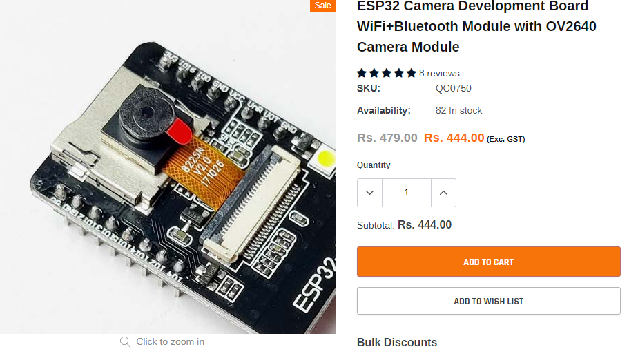
ESP32 camera sensor

Slide 4
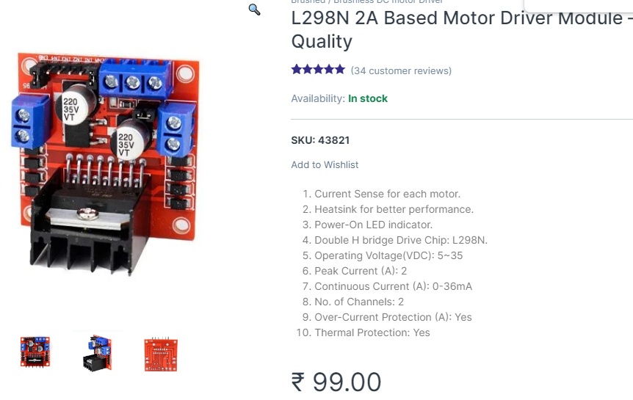
L298N Motor Driver

Slide 5
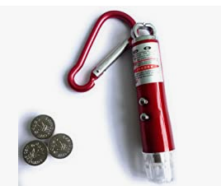
Laser light

Slide 6
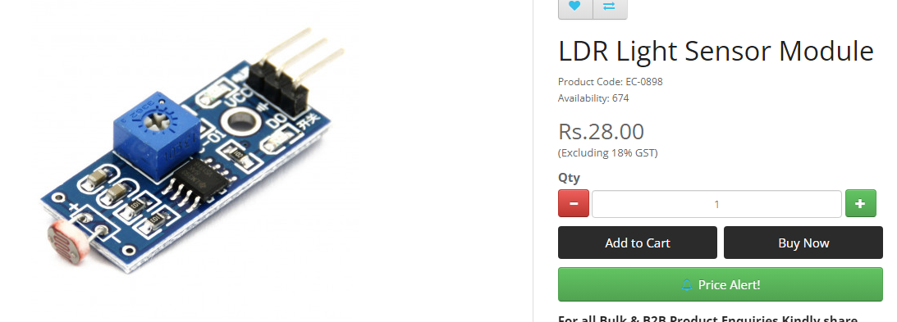
LDR sensor

Slide 7
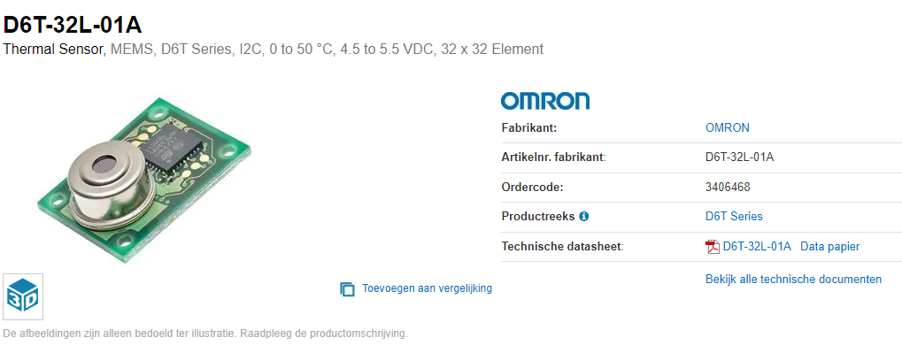
Omaran D6T - Thermal image sensor

Slide 8
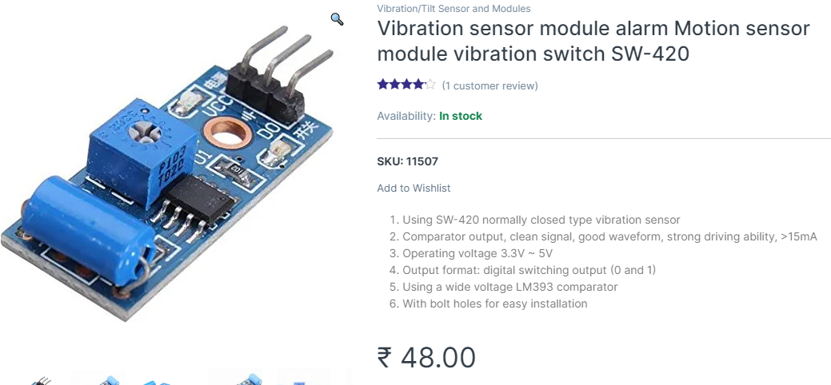
Vibration sensor

Slide 9
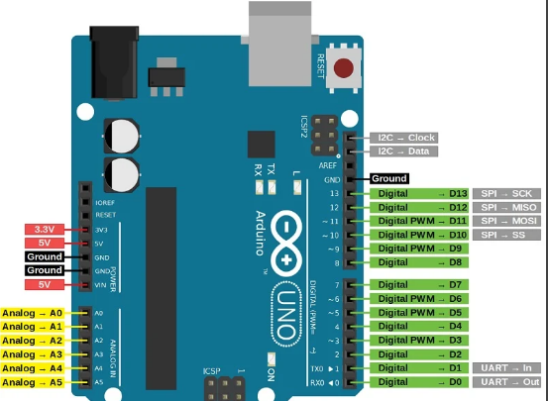
Arduino - UNO

Slide 10
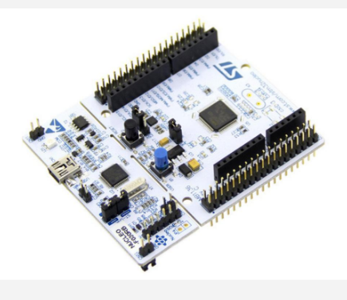
STM32F446RE-NUCLEO

